Slide 1
Mobile Applications Development 2
Damien Costello
damien.Costello@gmit.ie

Slide 2
Software
Visual Studio 2017
Xamarin
You will need an Android device or a Windows 10 machine for testing
MAC Users – will need to setup Xamarin on Mac and have your own device for testing

Slide 3
Aim & Assessment
Get App written using Xamarin to deploy on Android, Windows and maybe iOS (depending)
Using C#, XAML (markup language)
Understand the separation of common/shared/background functionality from the User Interface
Design an app that can be used
Doesn’t have to be a complicated app
100% CA assessment
There is a project for you to do – creating an app
There will be an element of inclass assessment also

Slide 4
This Week
Install Visual Studio 2017
I am using Community Edition, version 15.8.0
Azure Tools and functions installed
C# Tools 2.9.0-beta8-63208-01
Visual Studio Tools for Unity
Visual Studio Tools for Universal Windows Apps
Mac Extension for Visual Studio
Xamarin 4.11.0.732 (d15-8@33e83e124)
Xamarin Designer 4.14.218 (79f535bdd)
Visual Studio extension to enable Xamarin Designer tools in Visual Studio.
Xamarin.Android SDK 9.0.0.18 (HEAD/3d8a28f1a)
Xamarin.iOS and Xamarin.Mac SDK 11.14.0.13 (373c313)
Xamarin.iOS and Xamarin.Mac Reference Assemblies and MSBuild support.

Slide 5
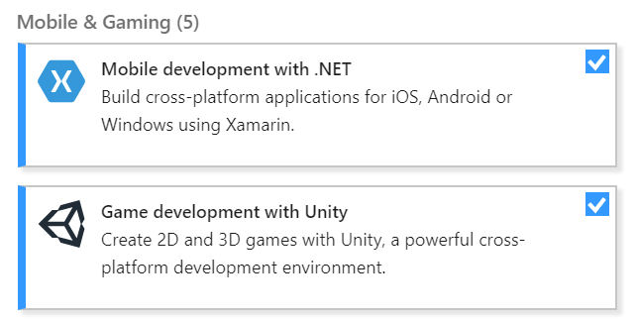
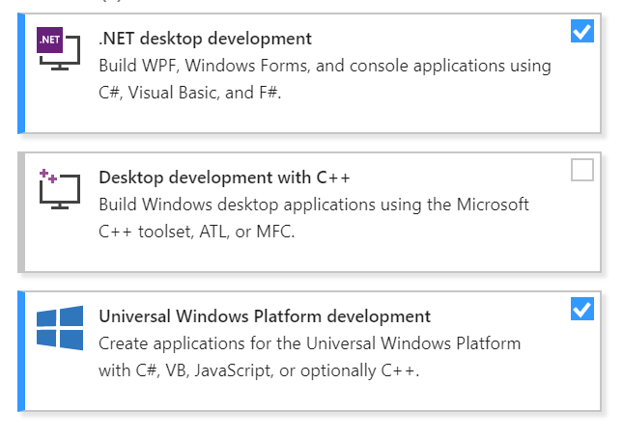

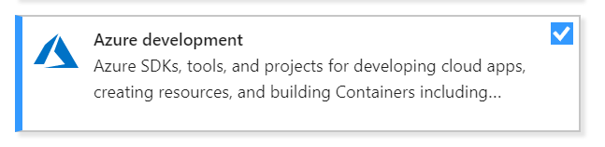
Installing

Slide 6
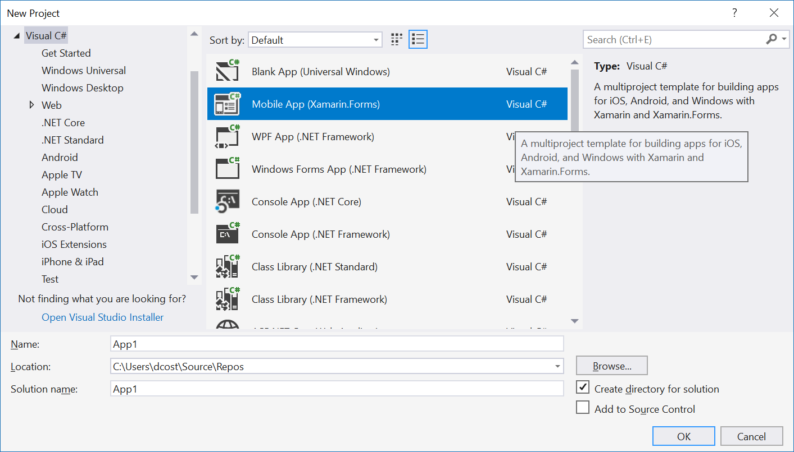

Slide 7
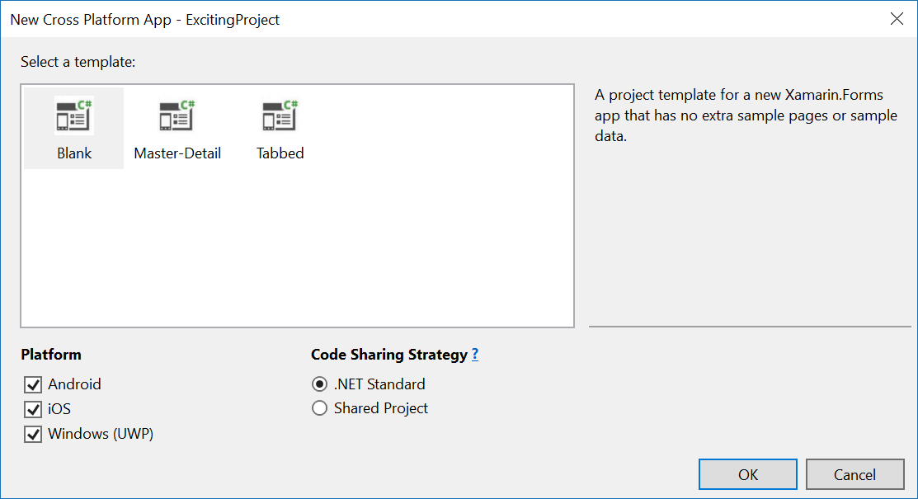

Slide 8
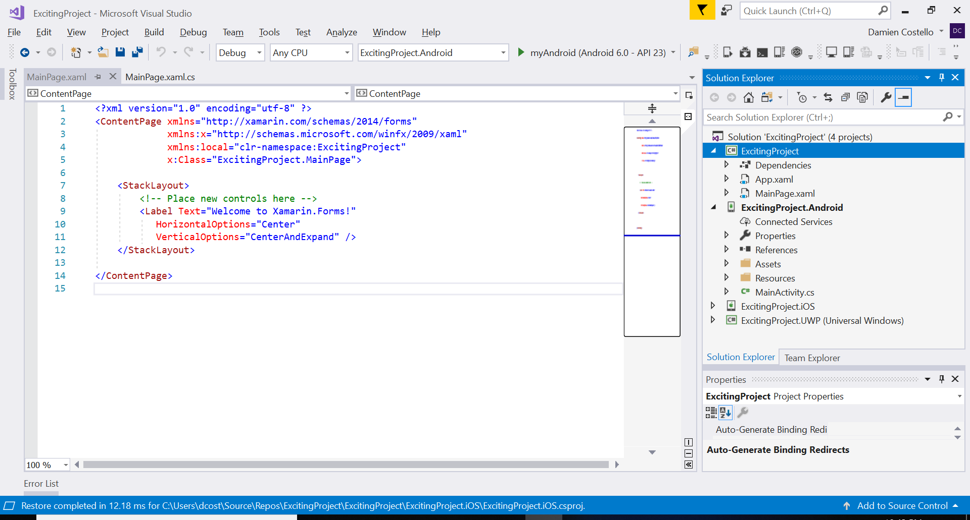
Project Setup

Slide 9
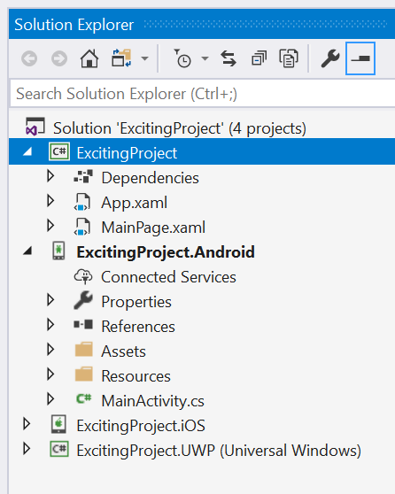
Solution
Solution Explorer
Properties Window
App.xaml
MainPage.xaml
Appxmanifest
Properties
References
Assets

